Slide 1
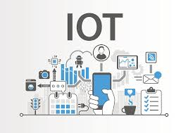
Sensing and Actuation in IoT Systems: How They Work Together in Automation

Slide 2
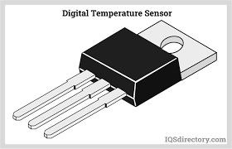
What is Sensing in IoT?
1
2
Physical Detection
Data Conversion
Sensors are the 'eyes' and 'ears' of IoT, detecting and measuring physical properties like temperature, motion, light, humidity, or pressure from the environment.
They convert these real-world analog signals into digital data, making them interpretable for processing by electronic systems.
3
Real-World Application
For example, a temperature sensor in a smart thermostat continuously measures room temperature, providing critical data for climate control.

Slide 3
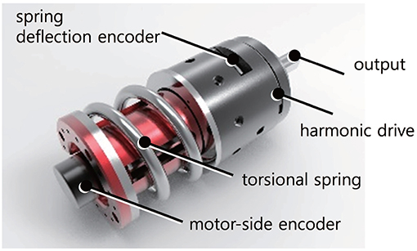
What is Actuation in IoT?
1
2
Command Execution
Physical Transformation
Actuators are the 'muscles' of IoT. They receive commands and convert electrical signals into tangible physical actions or movements.
They perform tasks such as opening or closing valves, rotating motors, adjusting dimmers, or switching lights on and off, directly impacting the physical world.
3
Practical Use
In a smart irrigation system, an actuator might open a precise valve to water specific sections of a garden based on soil moisture data.

Slide 4

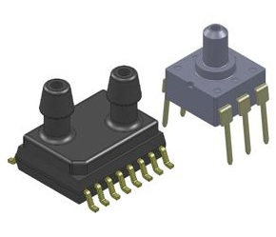



How Sensors and Actuators Work Together
Data Collection
Sensors gather environmental data, sending it to a central controller or cloud-based IoT platform.
Analysis & Decision
The system analyzes this data, applying predefined rules or AI algorithms to determine if a specific action is required.
Action Command
If an action is needed, commands are then transmitted to the relevant actuators to initiate physical changes in the environment.
Real-Time Control
This continuous feedback loop enables real-time automation and precise control, making IoT systems responsive and adaptive.

Slide 5
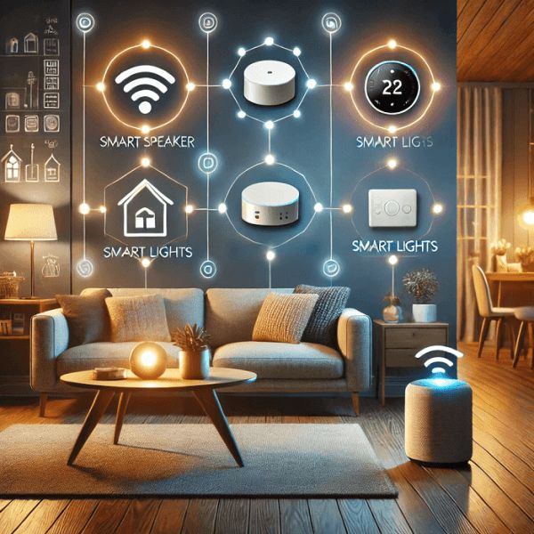
Real-World Example: Smart Home Automation
Intelligent Presence Detection
In a smart home, motion sensors strategically placed in rooms detect human presence. These sensors provide immediate data on occupancy.
Automated Response
If no motion is detected for a predetermined period, the central automation system sends commands. Actuators then turn off lights, adjust the HVAC system, or close smart blinds.
Enhanced Efficiency
This seamless integration leads to significant energy savings and enhanced comfort, all without any manual intervention from the occupants.

Slide 6
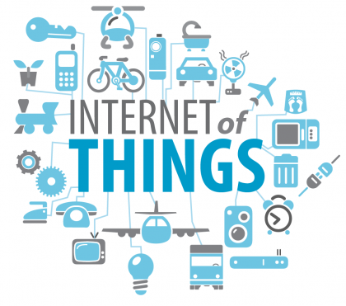
Why Sensing and Actuation Are Critical in IoT
Intelligent Interaction
They are the fundamental components enabling IoT devices to perceive and interact intelligently with the physical world, bridging the gap between digital and physical.
Driving Automation
These technologies are essential for driving automation across various sectors, from smart agriculture and manufacturing to advanced healthcare systems.
Improving Outcomes
By facilitating responsive control, they significantly enhance efficiency, bolster safety measures, and elevate user experience in countless applications.

Slide 7
The Future of IoT Automation: Smarter, Faster, More Connected
Advanced Components
Continuous advances in sensor miniaturization and actuator precision are leading to more compact, versatile, and reliable IoT devices.
AI-Powered Decisions
The integration of artificial intelligence and machine learning is profoundly enhancing sensor-actuator coordination, enabling more autonomous and predictive systems.
Seamless Integration
Greater interoperability and seamless integration will enable fully autonomous systems, transforming daily life and various industrial sectors.
IoT's Backbone
Together, sophisticated sensing and precise actuation form the indispensable backbone of the Internet of Things, powering its evolution and impact.

